Slide 1
User Analytics for Strategic Business Acquisition
Submited By:-
Himanshu sharma

Slide 2
Introduction
This project focuses on evaluating the strategic viability of acquiring TellCo, a telecommunications service provider operating in the Republic of Pefkakia. Commissioned by a private investor known for acquiring undervalued businesses, the objective is to perform a comprehensive data-driven analysis of TellCo’s user base to identify growth opportunities and determine whether the company represents a profitable investment.
Leveraging a month of aggregated data from xDR (Data Sessions Detail Records), this analysis aims to extract actionable insights through four key analytical pillars: User Overview, User Engagement, User Experience, and User Satisfaction. These pillars cover a spectrum of critical metrics—from handset usage patterns and application consumption to network performance and customer satisfaction.
The project delivers not only a detailed written report but also an interactive, web-based dashboard to visualize insights. Outcomes from this project will guide strategic decision-making on whether to acquire TellCo and how to enhance its profitability post-acquisition.

Slide 3
Libraries
Pandas and NumPy for data manipulation and aggregation
Matplotlib and Seaborn for data visualization
Scikit-learn for clustering (K-Means), dimensionality reduction (PCA), and regression modeling
Plotly for interactive dashboard visualizations
MySQL Connector or SQLAlchemy for database export and integration
Streamlit or Flask for building a web-based dashboard interface
MLflow or Docker for model versioning and deployment tracking

Slide 4
Project Overview
The goal of this project is to assess the acquisition
potential of TellCo, a telecommunications service provider in the Republic of Pefkakia, on behalf of a private investor who specializes in identifying undervalued businesses. TellCo has provided access to one month of raw system-generated xDR (Data Session Detail Record) data, which has never been previously analyzed.
The project involves extracting insights from this data to understand customer behavior, engagement, experience, and satisfaction. These insights will inform a strategic decision on whether the investor should proceed with the acquisition.

Slide 5
User Overview Analysis :- Identifying top handset models, manufacturers, and usage patterns to assist marketing strategies.
User Engagement Analysis :- Measuring user activity through metrics like session frequency, data usage, and clustering users based on engagement levels.
User Experience Analysis :- Evaluating network performance indicators such as TCP retransmission, RTT, and throughput, and clustering users based on their experience.
User Satisfaction Analysis :- Calculating engagement and experience scores to predict overall satisfaction and segment users for targeted improvements.

Slide 6
Problem Facing
Unclean and Unstructured Data:- The raw xDR dataset contained numerous missing values, duplicate entries, and inconsistent formats, requiring significant preprocessing to ensure data quality and reliability.
High Dimensionality:- With many application types and user behavior metrics, the dataset exhibited high dimensionality. This increased the complexity of clustering and correlation analysis, necessitating the use of dimensionality reduction techniques such as PCA.

Slide 7
Lack of Documentation Feature descriptions were either incomplete or unclear, which made it difficult to interpret some variables, especially technical ones related to network performance (e.g., TCP retransmission, RTT).
Imbalanced Usage Patterns A small number of users dominated total data traffic and session counts, skewing many of the metrics and requiring careful normalization and scaling before applying machine learning models.
Clustering Limitations Choosing the optimal number of clusters (k) for k-means was not always straightforward, especially when the elbow method showed no clear inflection point. This made segmentation and interpretation more subjective.

Slide 8
Resource-Intensive Computations Aggregating and analyzing large datasets across multiple dimensions led to memory and processing bottlenecks, especially when plotting or computing statistics on millions of session records.
Dashboard Integration Challenges Integrating real-time or interactive plots into Streamlit or Flask dashboards sometimes caused performance lags, especially when visualizing large aggregated tables or correlation matrices.
Database Export and Compatibility Exporting results to MySQL required additional data transformation steps, as some Python data types were not directly compatible with SQL schema formats.
Model Tracking and Deployment Complexity Tracking multiple versions of clustering and regression models, along with their parameters and outputs, introduced complexity—especially when using tools like MLflow or Docker for deployment and reproducibility.

Slide 9
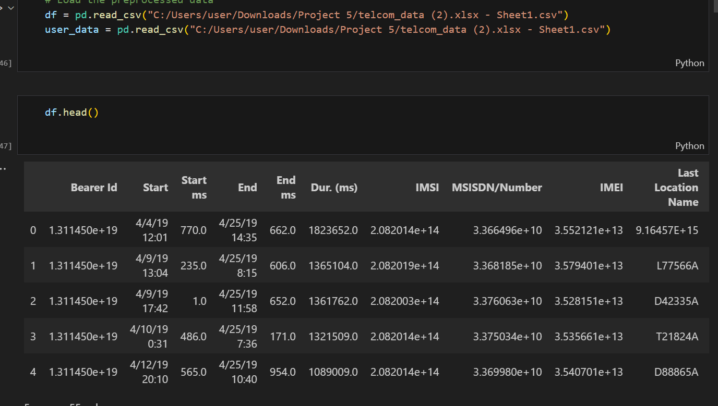

Slide 10
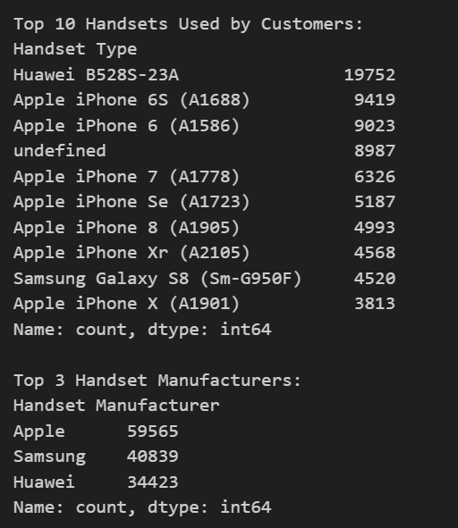
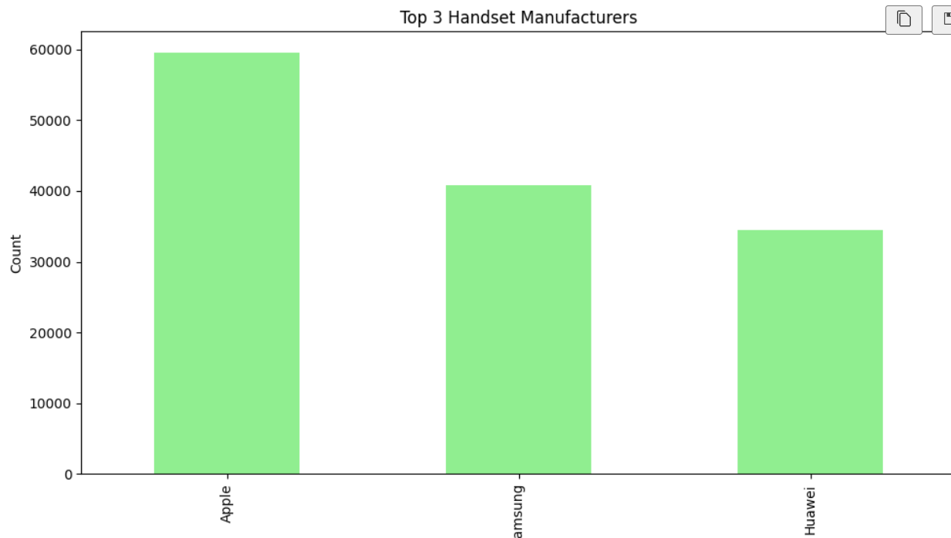

Slide 11
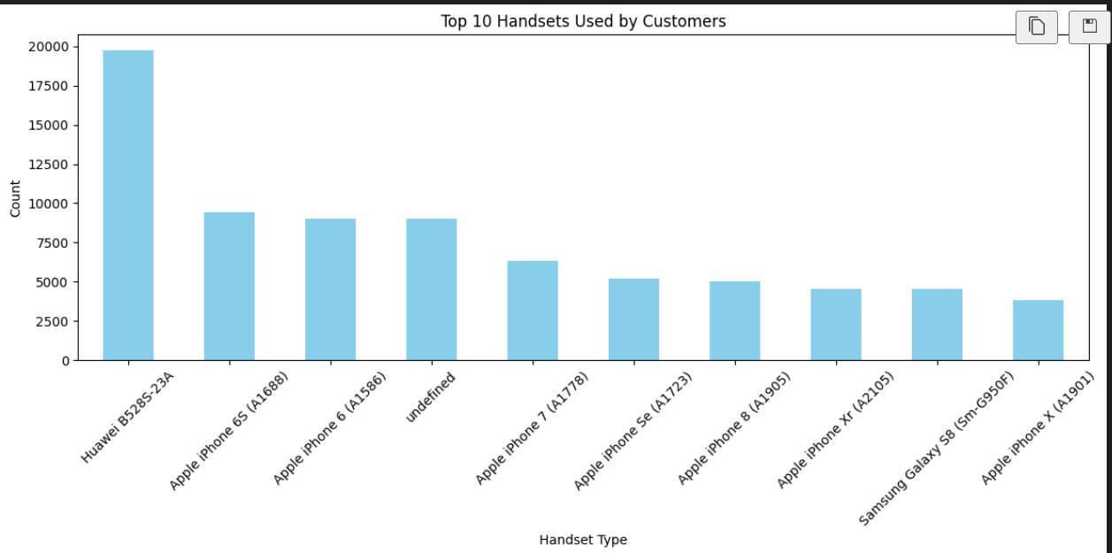

Slide 12
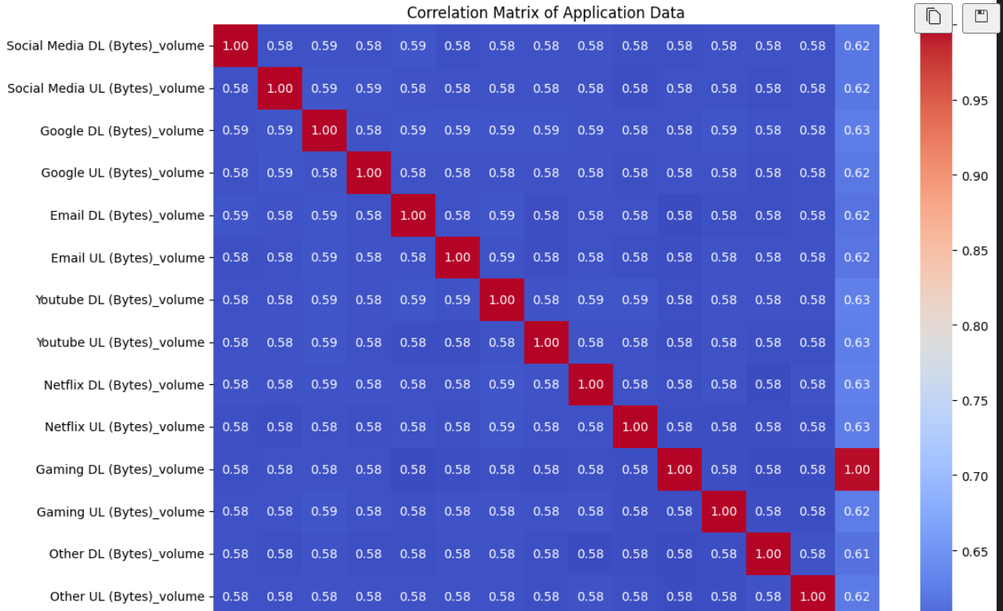

Slide 13
Conclusion
This project successfully demonstrated the power of data-driven decision-making in evaluating the acquisition potential of TellCo, a telecommunications provider in the Republic of Pefkakia. Through the analysis of one month of xDR data, the project delivered comprehensive insights across four key dimensions: User Overview, User Engagement, User Experience, and User Satisfaction.
Key findings include identification of top handset manufacturers and models, segmentation of users based on activity and network performance, and estimation of user satisfaction using combined engagement and experience scores. These insights were used to cluster users into actionable segments, revealing opportunities to improve service quality, increase customer retention, and ultimately drive profitability.
Despite facing challenges such as unstructured data, high dimensionality, and integration issues, the project leveraged robust Python libraries and tools—such as Pandas, Scikit-learn, Matplotlib, and Streamlit—to clean data, perform analysis, and present findings via a user-friendly dashboard.
The final deliverables, including a well-structured database, predictive model, and interactive dashboard, provide a solid foundation for the investor to make an informed decision. Based on the findings, TellCo holds strong potential for growth and optimization, making it a viable candidate for acquisition—provided targeted improvements in user experience and satisfaction are implemented.

Slide 14
Thank You

